Slide 1
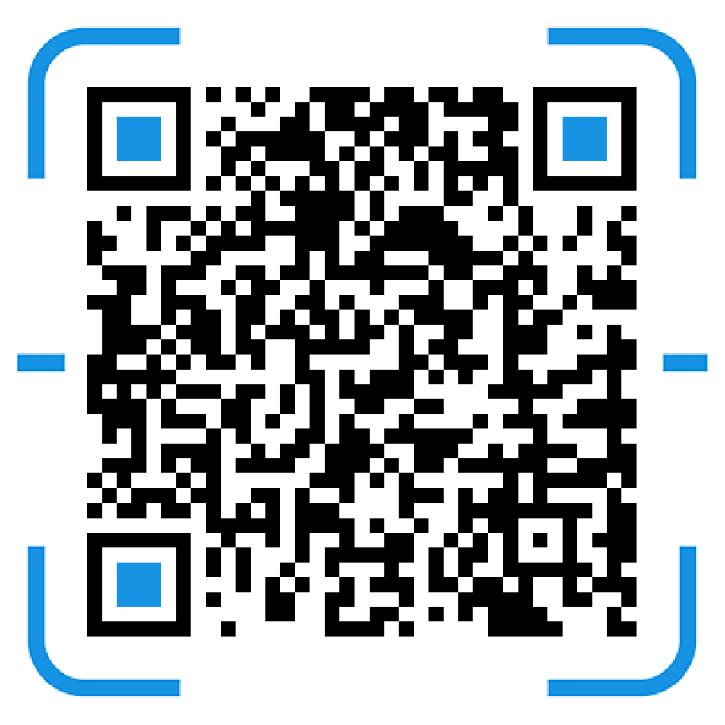
2
RPi GPIO pin control
Join us in Telegram chat!

Slide 2
Join IEEE Exco to go beyond your boundary!
Want to become an IEEE member?
Approach any of the exco members to find out more about what we do
Approach any of the exco members to find out more! @ieeesutd_bot on Telegram is here to help you :)
Notes:
Publicity page

Slide 3
Maker Extravaganza
Date: 18 October 2019, Friday Location: Singapore Science Centre Time: 1pm (Meet at campus centre)
3 more openings! We will be providing transport from school to the science centre
Registration link: http://bit.ly/makerfaire2019
Find out more: https://sciencecentresg.shinyapps.io/sgme2019/ https://makerfaire.com/makerfairehistory/
Notes:
Publicity page

Slide 4
Join the AC-DC converter Project!
Talk to our Project Director Dhruv to find out more about this exciting project! Indicate interest here:
https://forms.gle/SRT3VAL8GsprdW437
Registration link: http://bit.ly/makerfaire2019
Notes:
Publicity page

Slide 5
Date: 9 October 2019
Instructor Name: Yuxuan, Jason
Objectives:
Understand how RPi connects hardware components
Learn how to code GPIO pin control using Python in RPi
Complete simple traffic light project
Complete ultrasonic distance alert project

Slide 6
What you need:
RPi
Jumper wires
Breadboard
LEDs
Resistors
Buttons
Ultrasonic sensor
Micro USB power cable
laptop

Slide 7
Let’s get started!
1
Introduction to RPi

Slide 8
open “VNC Viewer” on your laptop
Notes:
Before going into intro, let students connect to RPi first, and install update and GPIO library, while installing, can do introduction to them

Slide 9
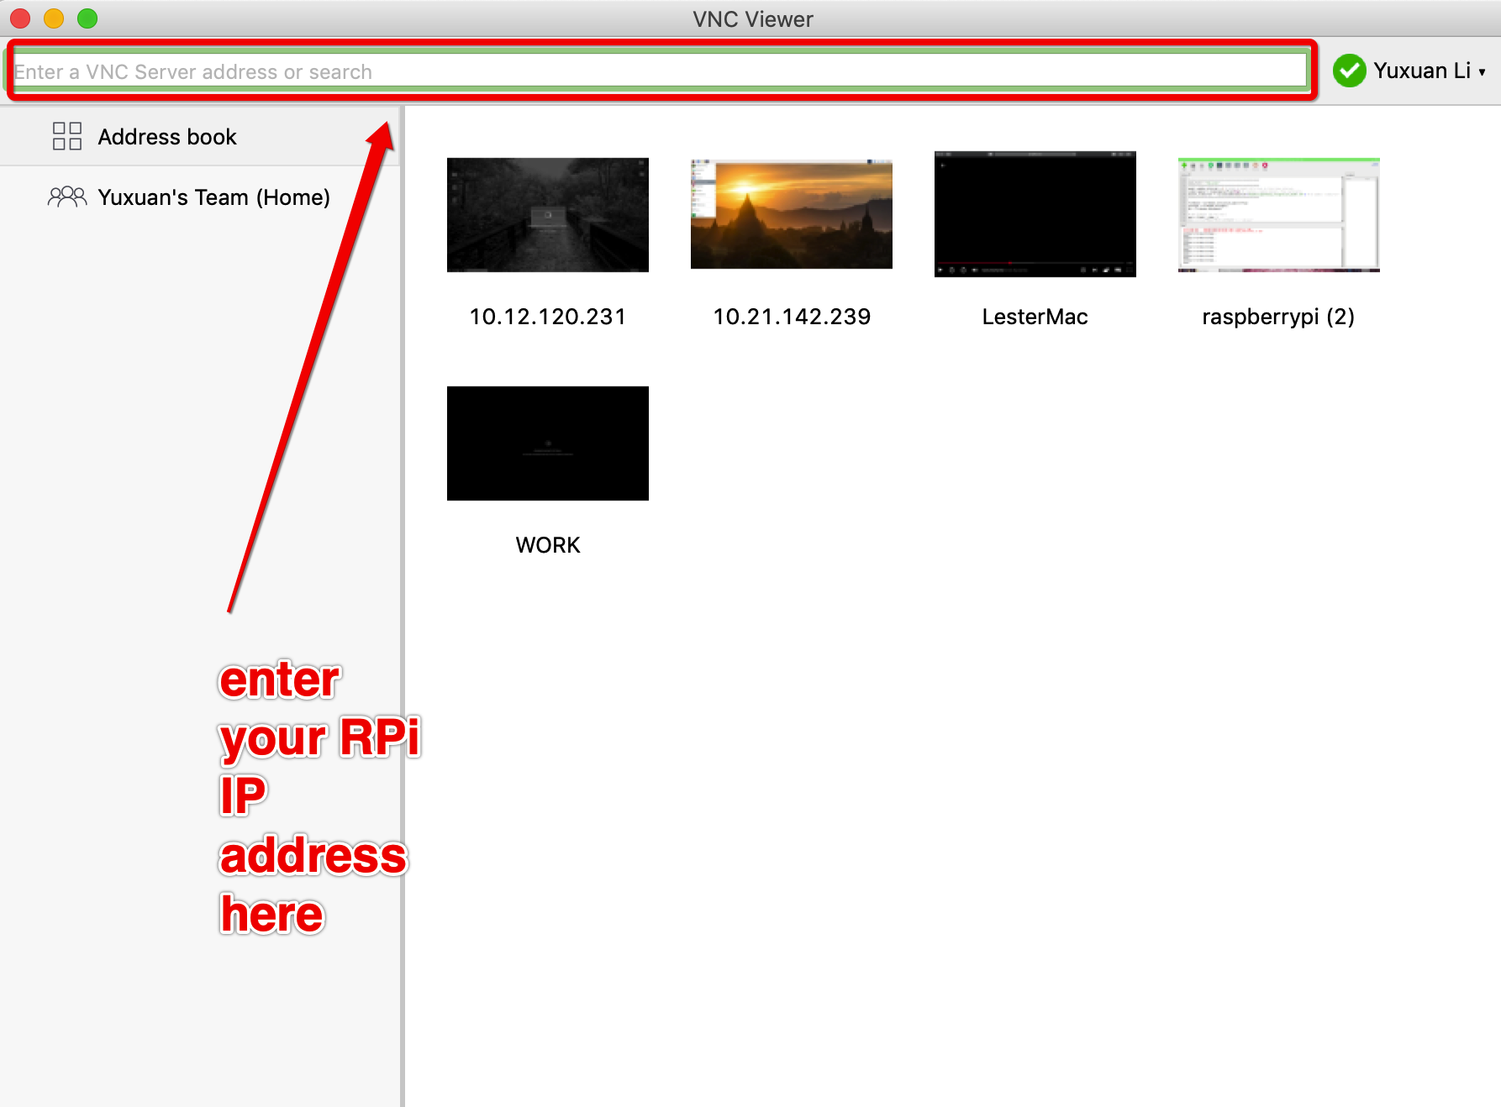

Slide 11
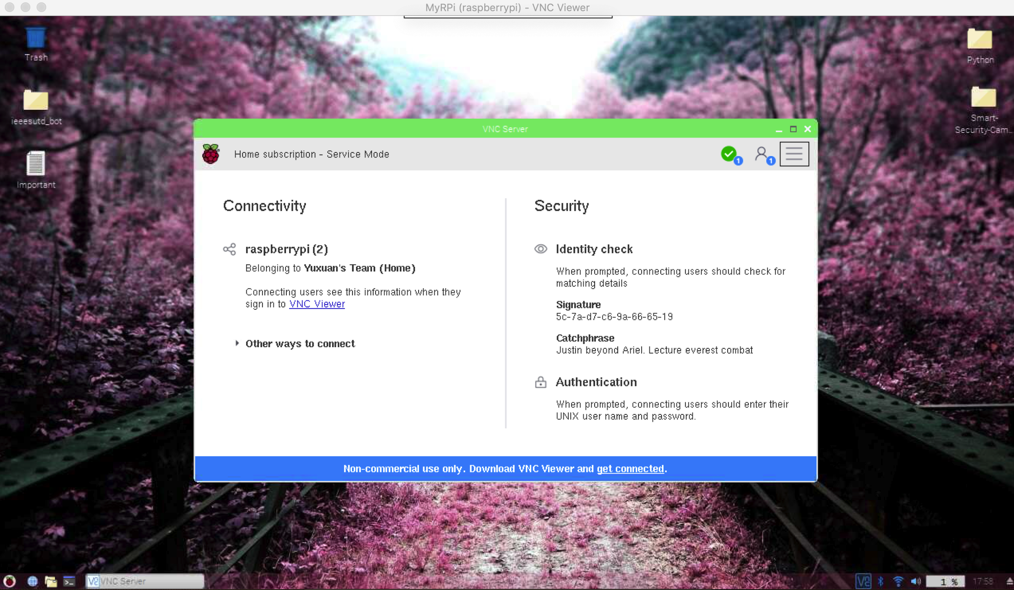

Slide 12
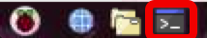
Now let’s add the GPIO library
Open “Terminal” on RPi
$ sudo apt-get update
$ sudo apt-get install rpi.gpio

Slide 13
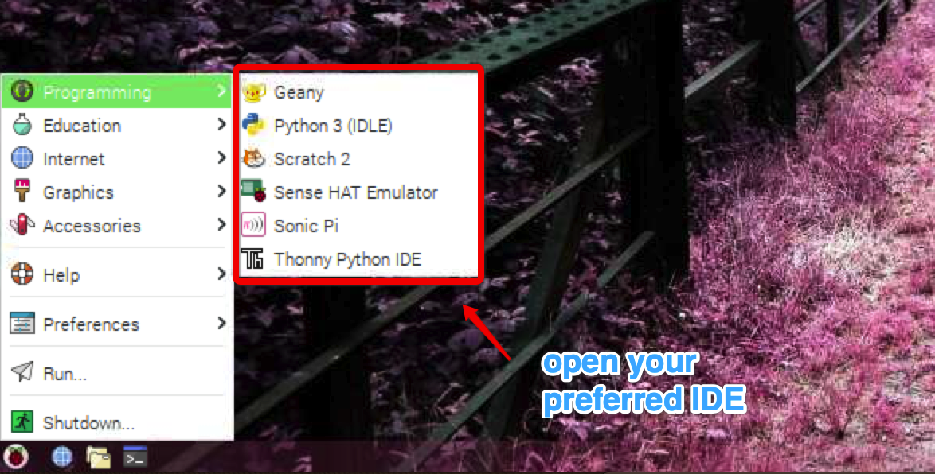

Slide 14
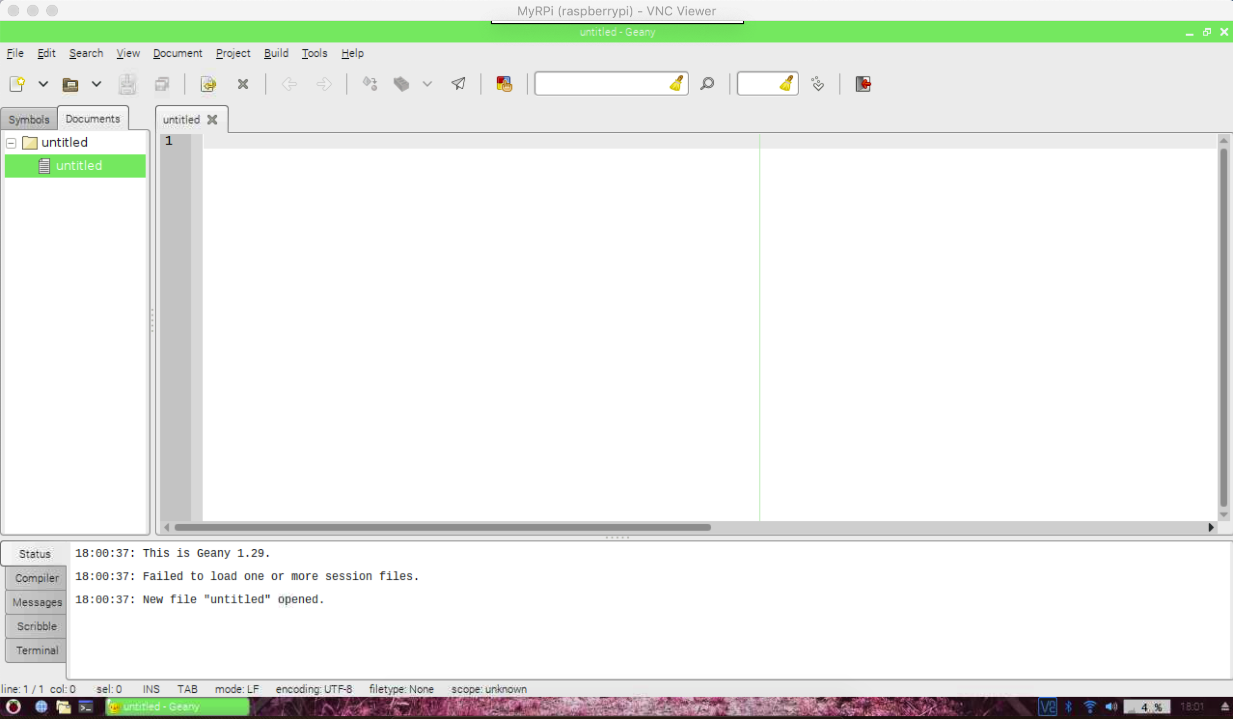
This is your Python IDE interface. You will be coding here.

Slide 15
This is your Python IDE interface. You will be coding here.

Slide 16
2
Traffic Light System

Slide 17

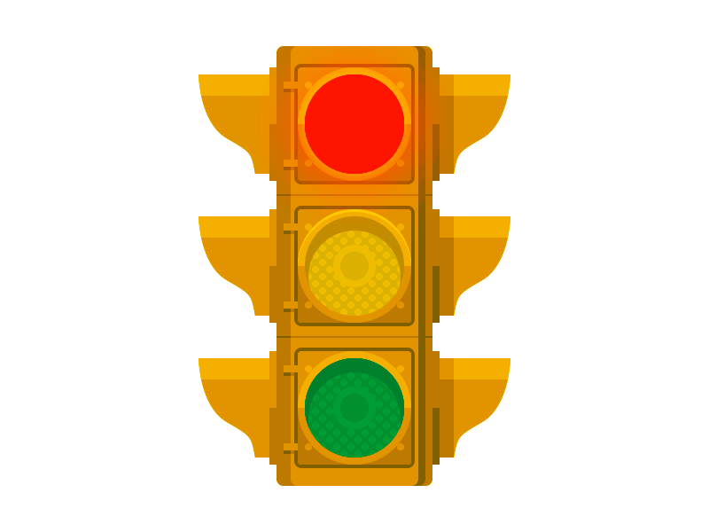
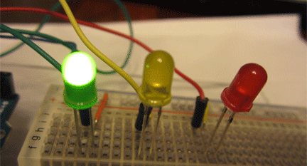
Traffic light system
In this activity, we are going to create a simple traffic light system

Slide 18
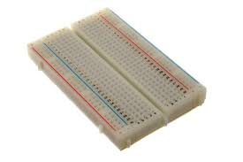
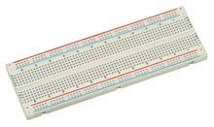
Breadboard
What is a breadboard?
Breadboard are prototyping board us for constructing circuit temporary. Power rating per spring clip is 5W

Slide 19
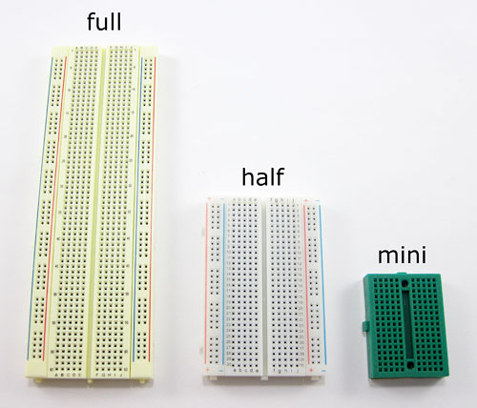
Common types of Breadboard
There are 3 common types of Breadboard, they are 1) Full-size 2) Half-size
3) mini

Slide 20
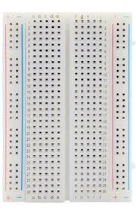
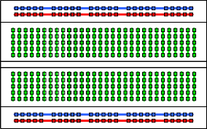
Half-size breadboard
Lines indicates that the whole row is connected internally.

Slide 21
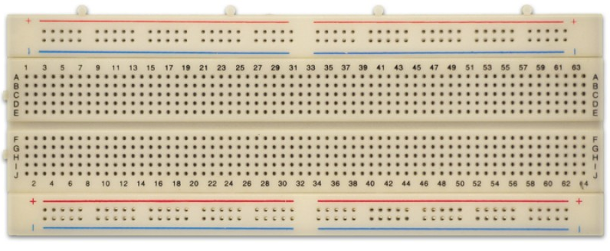
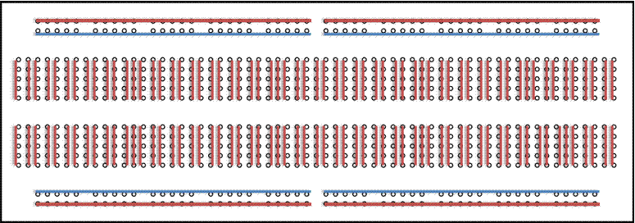
Full-size breadboard with breaks
Lines indicates that the whole row is connected internally.

Slide 22
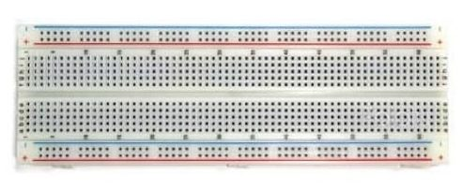
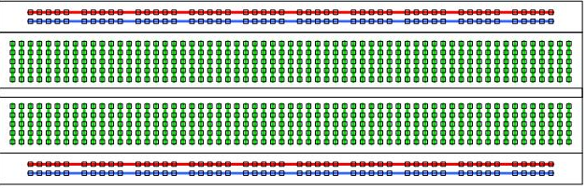
Full-size breadboard without breaks
Lines indicates that the whole row is connected internally.

Slide 23
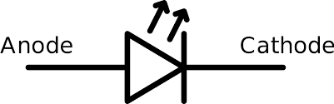
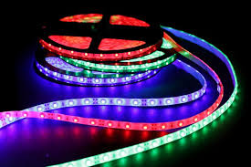
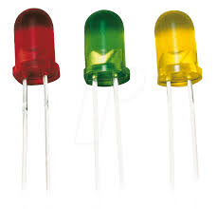
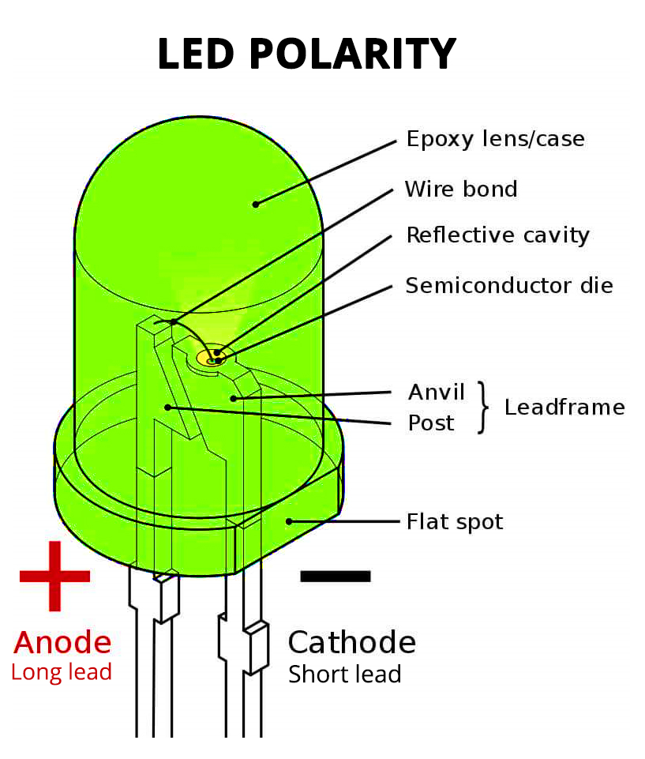
Light emitting diode (LED)
LED are diode that emits light. Just like a diode, it allows current to flow in one direction from its Anode (+) to its Cathode (-).
There are 3 ways to sport the polarity of the LED
The longer lead is the Anode (+) of the LED.
The Flat spot on the LED is the Cathode (-) side.
The Post of the LED’s Lead frame is the Anode (+).

Slide 24
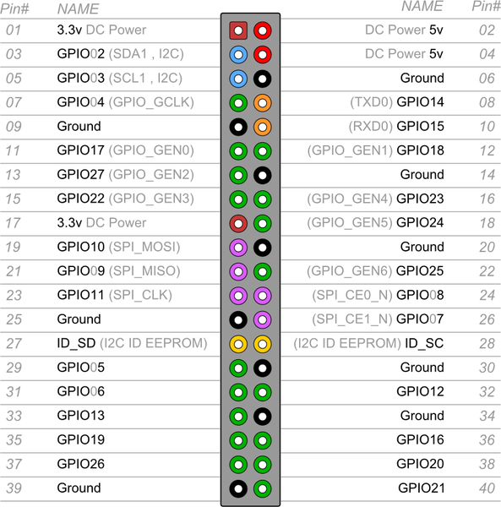
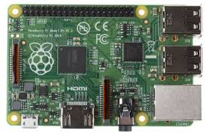
Pin Layout

Slide 25
More information about pin layout
https://pinout.xyz/
Notes:
Use this website to explain to students the GPIO pin labels and how later on we define the pin mode and input or output to control hardware components

Slide 26
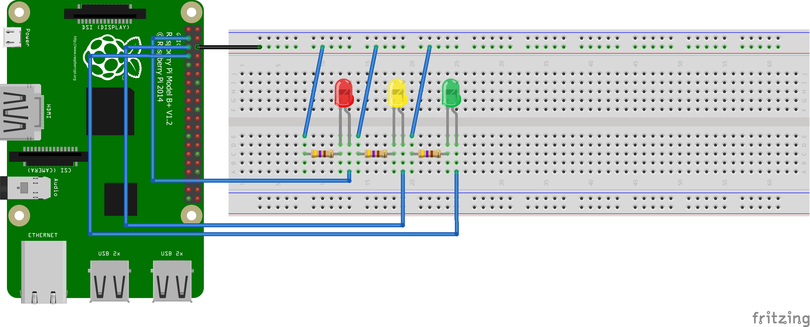

Traffic light circuit connection

Slide 27
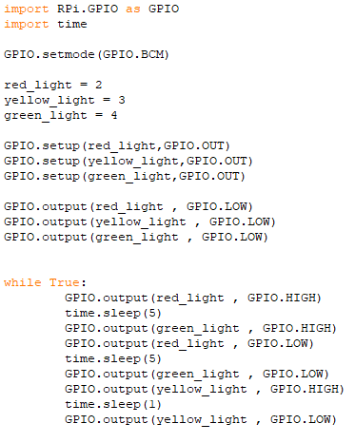
Code for
Traffic light circuit

Slide 28
3
Ultrasonic Distance
Detection with Alert Feedback

Slide 29
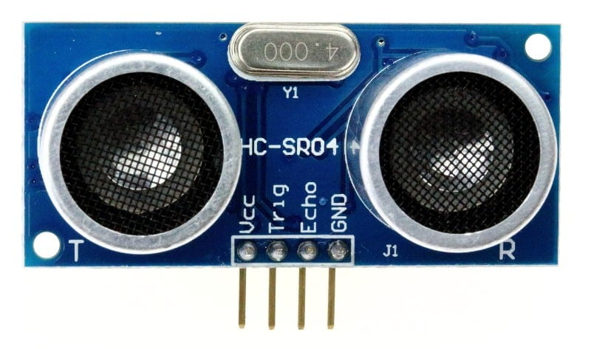

Slide 30
What we need?
Send signal and receive signal
Stopwatch to time duration between send and receive
Calculate distance based on speed of sound
Display distance
Conditional statement to alert users when too close

Slide 31
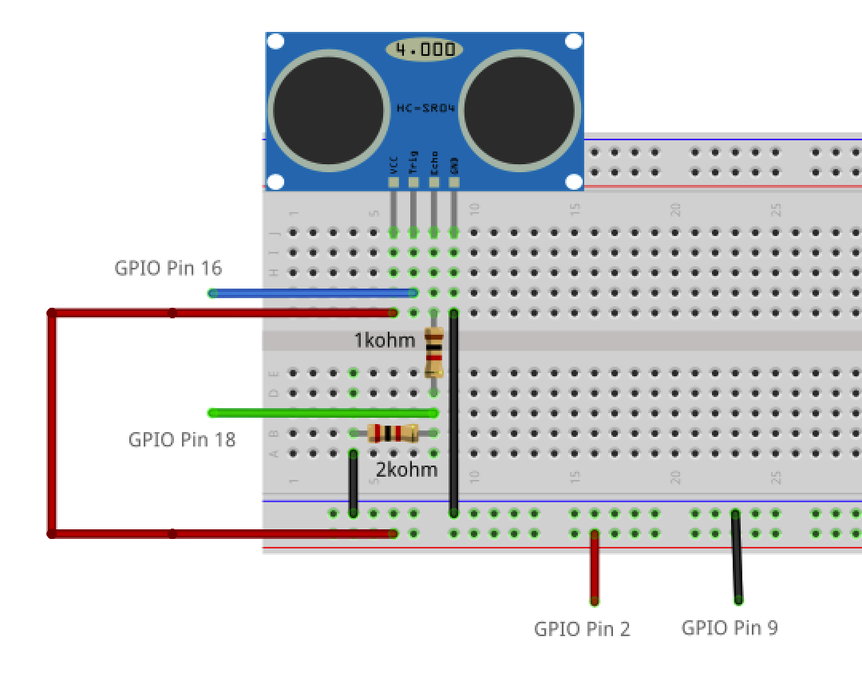
Notes:
Build your circuit!

Slide 32
Let’s code!
RPi.GPIO library
time library
RPi.GPIO.setmode(GPIO.BCM)
RPi.GPIO.setup(pin,GPIO.IN/GPIO.OUT)
RPi.GPIO.input(pin)
RPi.GPIO.output(pin)
RPi.GPIO.cleanup()

Slide 33
ultraDetector.py

Slide 34
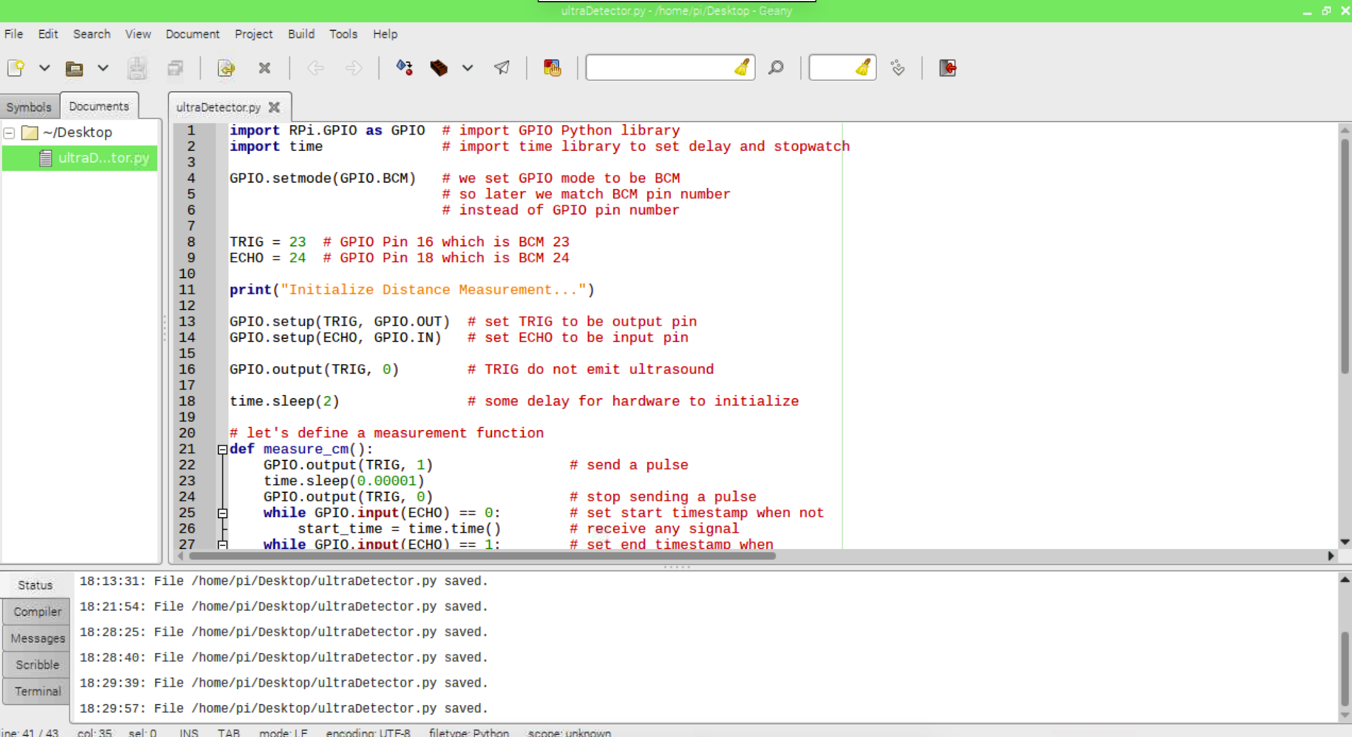

Slide 35
Challenge!
Implement a conditional statement at main loop that check if the distance is too short (you can decide the threshold value). If too short, print “DANGER”. If in safe distance, print “SAFE”

Slide 36
Join IEEE Exco to go beyond your boundary!
Want to become an IEEE member?
Approach any of the exco members to find out more about what we do
Approach any of the exco members to find out more! @ieeesutd_bot on Telegram is here to help you :)
Notes:
Publicity page

Slide 37
End of workshop
Thank you all for coming!

Slide 38
SlidesCarnival icons are editable shapes.
This means that you can:
Resize them without losing quality.
Change fill color and opacity.
Change line color, width and style.
Isn’t that nice? :)
Examples:

Slide 39

WEBSITE
http://handdrawngoods.com
LICENSE
Creative Commons Attribution 2.5 License
SHALL I GIVE CREDIT?
Yes
You are free to use them in your personal and commercial projects, and make any changes you like. However, please, always credit the designer of the set. Include a link back to handdrawngoods.com in your credits, within a readme file or equivalent documentation for the software which includes the icons.

Slide 40
WEBSITE
http://handdrawngoods.com
LICENSE
Creative Commons Attribution 2.5 License
SHALL I GIVE CREDIT?
Yes
You are free to use them in your personal and commercial projects, and make any changes you like. However, please, always credit the designer of the set. Include a link back to handdrawngoods.com in your credits, within a readme file or equivalent documentation for the software which includes the icons.

Slide 41

WEBSITE
https://fontawesome.com/
LICENSE
Creative Commons Attribution 4.0 International
SHALL I GIVE CREDIT?
Yes
You must give appropriate credit, provide a link to the license, and indicate if changes were made. You may do so in any reasonable manner, but not in any way that suggests the licensor endorses you or your use.

Slide 42
WEBSITE
https://fontawesome.com/
LICENSE
Creative Commons Attribution 4.0 International
SHALL I GIVE CREDIT?
Yes
You must give appropriate credit, provide a link to the license, and indicate if changes were made. You may do so in any reasonable manner, but not in any way that suggests the licensor endorses you or your use.

Slide 43
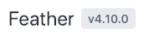
WEBSITE
https://feathericons.com/
LICENSE
MIT License Copyright (c) 2013-2017 Cole Bemis
SHALL I GIVE CREDIT?
Yes
A link to the license, copyright notice and permission notice shall be included.

